Slide 1
Changes in Ethernet Standard
Presented by – md Farhan Ishmam
Id - 180041120

Slide 2
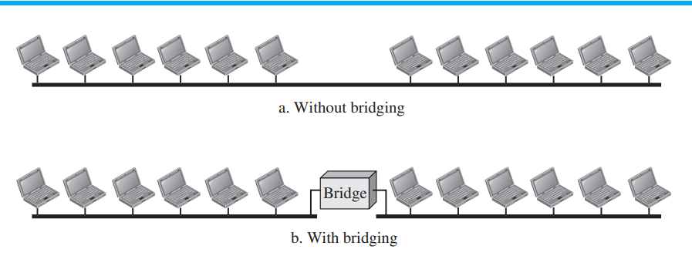
Bridged Ethernet
Raising the Bandwidth
Separating the Collision Domain
Notes:
Raising the Bandwidth
Separating the Collision Domain

Slide 3
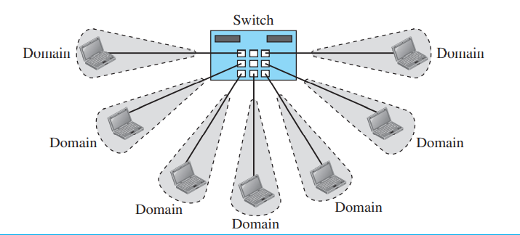
Switched Ethernet
A layer-2 switch is an N-port bridge with additional features that allows faster handling of the packets

Slide 4
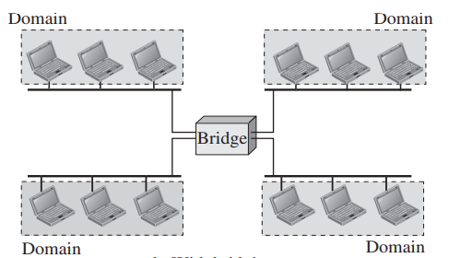
Key Differences Between Bridge and Switch
Bridges generally connect fewer networks as compared to the switch.
Switch has a buffer for each link connected to it which is missing in a buffer.
Switch perform error checking which is not done in a buffer.

Slide 5
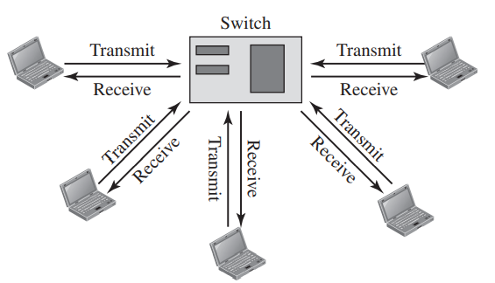
Full Duplex Ethernet
No CSMA/CD: Each node has a point to point link for transmission and receiving
MAC Control Layer: Between LLC and MAC layer to provide flow and error control
Notes:
Standard Ethernet was designed as a connectionless protocol at the MAC sublayer. There is no explicit flow control or error control to inform the sender that the frame has arrived at the destination without error. When the receiver receives the frame, it does not send any positive or negative acknowledgment.

Slide 6
Thank You!

